Slide 1
Students and teachers agreement
Credits:
Graphic Team:
-Perego Agata
-Ivanovici Alecsandra
-Xheraj Arlen
-Valeri Mattia
-Ferrari Filippo
-Fumagalli Federico
-Bouhachkar Nasim
-Lugo Emanuele
Writing Team:
-Fam Elisa
-Sirignano Luigi
-Saronni Diego
-Bollani Riccardo
-Biella Sabrina
-Amuraritei Aurora
-El Sayed Giumana
-Gennari Matteo
-Lo Russo Andrea
-Giambelli Alessia
-Lo Giacco Noemi
Cooperation and team work help​
students and teachers reach their goal more easily.​

Slide 2
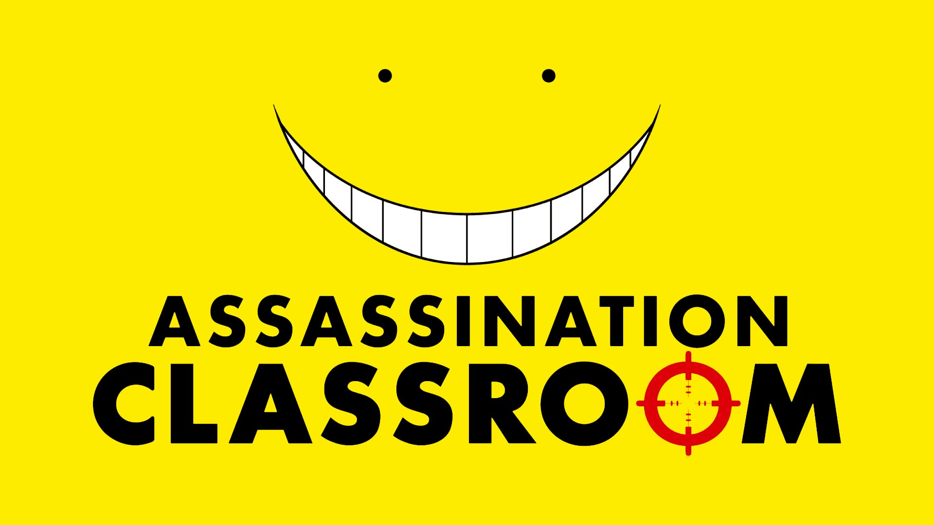
Teachers & Students
Agreement
Teachers’ obligations:
They must talk to students when students have a problem.
They must prepare their lesson before getting to school.
Not necessary
for teachers:
They don’t have to give students heaps of homework.
They don’t have to use bad words with students.
Mustn't
for teachers:
They mustn't have a favourite student.
They mustn't insult students
Students' obligations:
They must dress correctly.
They must respect the rules.
Mustn't for students:
They mustn't waste time.
They mustn't sleep at all time.
They mustn't smoke.

